Slide 1

Stray Cattle
Detection

Slide 2

Outline
Problem Statement
Working Mechanism
Detection Mechanism
Components
Visual Outlets

Slide 3
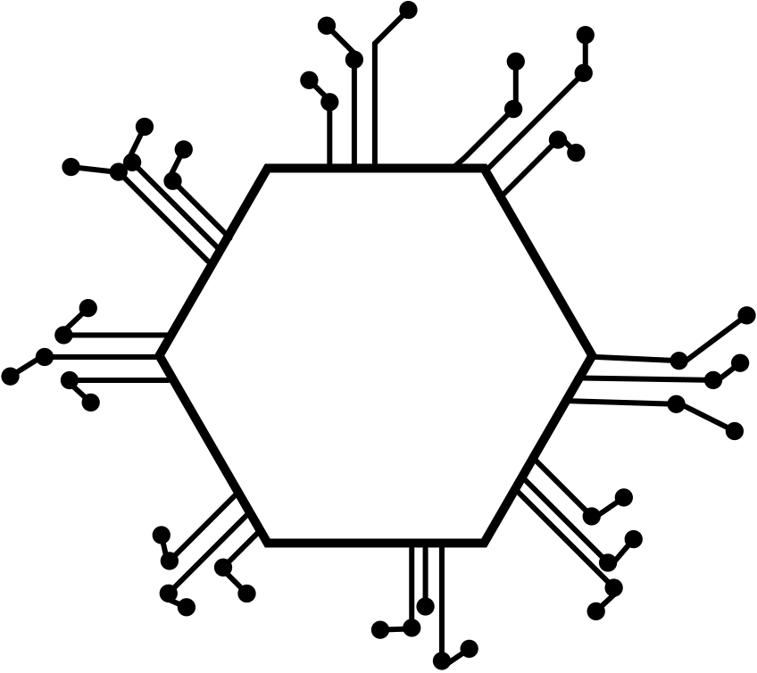
Problem Statement
The issue of stray cattle roaming on the busy roads is very severe. This issue arises when cattle are either abandoned by their owners or left unattended due to various reasons such as ageing or other complications. These stray cattle pose a significant hazard to public safety, leading to traffic disruptions and potential accidents on the roads.

Slide 4

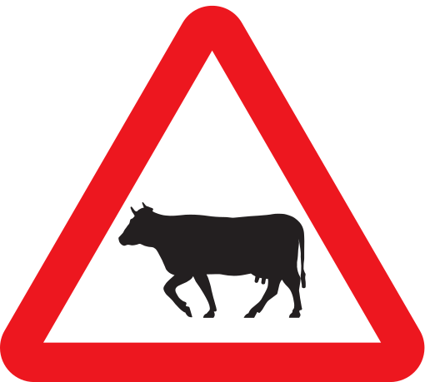
Working Mechanism
Custom Data Set Preparation:
Collect images of stray animals from municipal cameras.
Annotate these images with bounding boxes around the animals.
Organize the data into a custom dataset.
Training Using YOLO Algorithm:
Utilize the custom dataset to train a YOLO (You Only Look Once) object detection model.
YOLO is efficient for real-time object detection and can be trained to detect multiple classes, including stray animals.
Real-Time Detection:
Utilize the trained YOLO model to analyze the live feed from municipal cameras.
Detect stray animals in the camera feed by applying the object detection algorithm

Slide 5
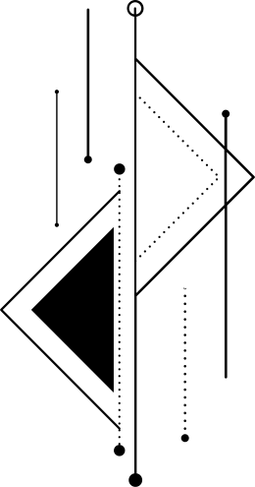

Location Tracking:
Once a stray animal is detected, extract its location information from the camera feed.
Utilize GPS or location data associated with the camera to pinpoint the exact location of the detected animal.
Alert Generation:
Send an alert message to municipal workers or animal control authorities.
Include the location information of the detected stray animal in the alert message.
Response and Intervention:
Upon receiving the alert, municipal workers can respond promptly to the location provided.
Take appropriate action to handle the situation, such as capturing or relocating the stray animal.
Feedback Loop:
Collect feedback from municipal workers regarding the effectiveness of the system.
Use this feedback to refine the object detection model and optimize the system for better performance.

Slide 6

Detection Mechanism
The detection and capture mechanism involve continuous analysis of live video feed from municipal cameras using a trained YOLO object detection model. Once a stray animal is identified with high confidence, its location is extracted from the feed and an alert message is generated, including timestamped location information. This alert is promptly transmitted to municipal workers for intervention. Upon receiving the alert, workers locate and capture the stray animal, employing appropriate procedures for safe handling. Post-intervention, the system is updated to reflect the animal's removal or relocation, ensuring continued effectiveness in addressing stray animal incidents.

Slide 7

Components
GPU (Graphic Processing Unit)

Slide 8
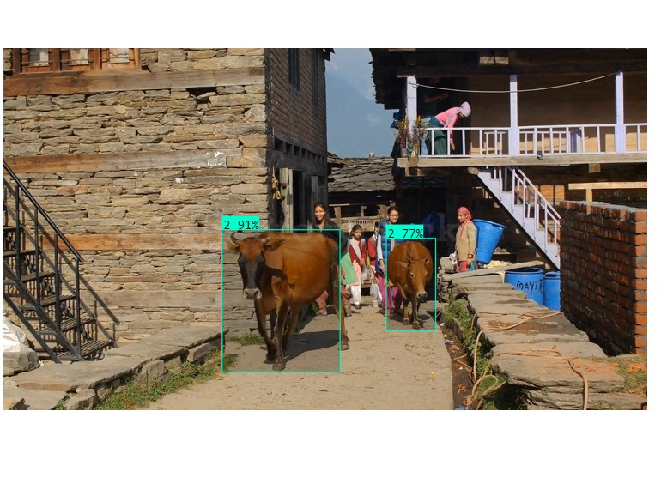
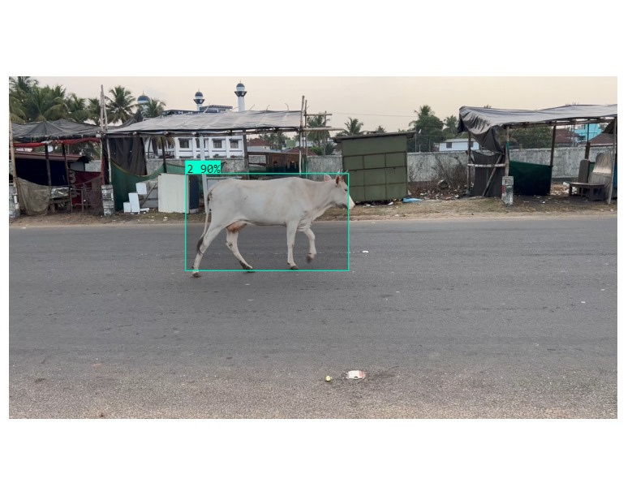
Visual Outlets

Slide 9
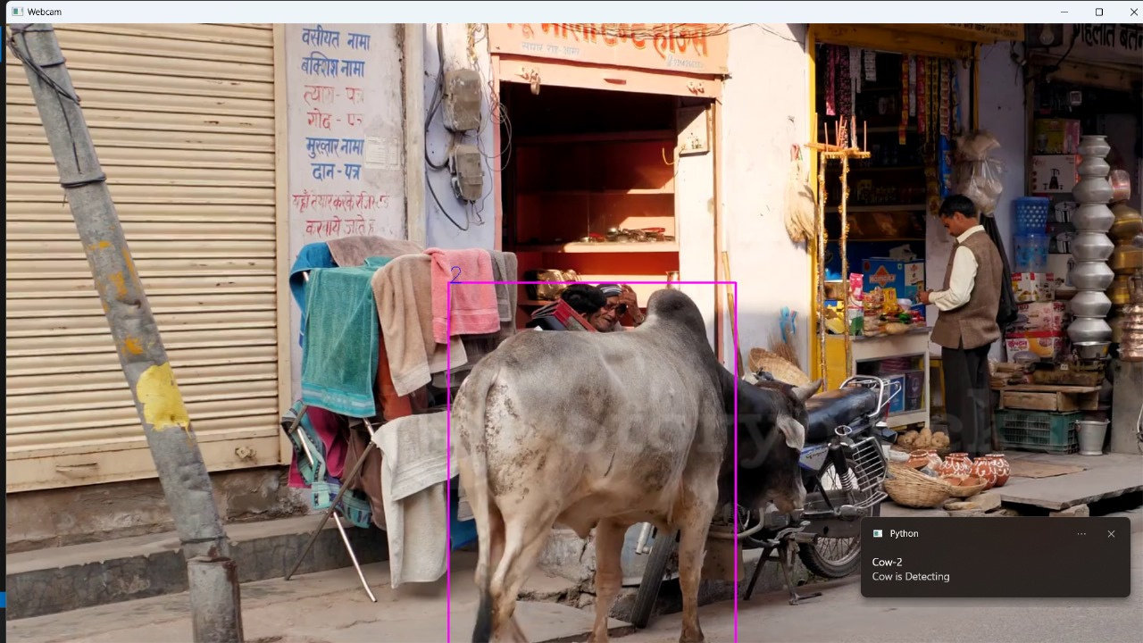



.

Slide 10
Future Enhancement
Future improvements in animal detection aim to enhance accuracy by deploying advanced algorithms, deep learning models, and high-resolution cameras.
Real-time processing through cloud and edge computing, coupled with collaboration with animal experts, ensures swift and precise identification of multiple animals, especially focusing on distinguishing between stray and controlled environments.

Slide 11
Thank You

